Slide 1
ENERGY FUNDAMENTALS & APPLICATIONS Lecture 1
INTRODUCTION & PRELIMINARIES
Intellectual property of Calvin M. Wolff and is to be used only by permission: calvin@cmwolff.com

Slide 2
COURSE OBJECTIVE
To provide a thorough and well substantiated understanding of the nature, sources, technology, distribution and economics of energy.

Slide 3
COURSE OBJECTIVES - Detailed
Learn the basic scientific principles of
Chemistry
Mechanics
Thermodynamics
Thermochemistry
Inefficiencies
Electro-magnetism
Electric Power
Light
Heat Transfer
Fluid Flow
To understand
Wind Turbines
Solar Cells
Hydroelectric Power
Lighting
Air Conditioning
Auto & Diesel Engines
Steam Engines
Jet Engines
Electric Generators
Electric Motors
Electric Power Generation, Transmission & Distribution
Learn the economics of energy

Slide 4
COURSE CONDUCT
Save Questions Until End of Lesson – there is a lot of material and time is critical
Some numerical problems
Comments are Welcome after/before Class and via e-mail
I’ll make time for you.

Slide 5
MACRO ENERGY UNITS
U.S. Energy Information Administration (EIA)
BTU = (British Thermal Unit) heat required to raise temperature of one pound water one degree Fahrenheit
(Calorie = heat required to raise temperature of one gram water one degree Celsius) 1 calorie = 4.186 joules =
Quad = One Quadrillion (10¹⁵) BTU’s 1 barrel of oil has 5.8 Million BTU’s, at $50/bbl one Quad of Oil is Worth $8.6 Billion;
1 MMBTU Natural Gas is worth $3, 1 Quad Natural Gas is Worth about $3 Billion
Global Energy Statistics: Reserves & Resources (used in Text)
Exajoule (EJ) = 10¹⁵ Kilojoules = 957 Quads

Slide 6
ENERGY RESOURCES & RESERVES
RESOURCE is the estimated global natural occurrence of a particular form of matter or energy
RESERVE is the subset of the resource that is available for exploitation today
Relatively precise knowledge of location & magnitude
Technological capability to extract and process deposits
Projected cost of production that is below or near current market prices

Slide 7
SUMMARY OF GLOBAL FOSSIL FUEL ESTIMATES
(Excludes Methane Hydrates)
 | As of Year 2000 in Exajoules
FUEL | Reserves | Resource | Estim. Years*
Coal | 21,000 | 200,000 | <400
Conventional Oil | 6,000 | 12,000 | <150 combined
Unconventional Oil | 5,000 | 20,000
Conventional Nat Gas | 5,500 | 16,500 | <300 combined
Unconventional Nat Gas | 9,500 | 33,000
Total Fossil | 47,000 | 281,500
Uranium, non-Breeder | 1,900 | 8,500 | 47
Uranium, Breeder | Very Large | Very Large | Very Long

Slide 8
ENERGY SOURCES
FUNDAMENTAL: Nuclear & Gravity
PRIMARY
Fossil: Coal, Oil, Oil Shale, Oil Sand, Nat. Gas, Methane Hydrates
Nuclear: Fusion & Fission - Breeder & Non-Breeder
Renewable: Solar, Wind, Hydro (e.g. Dams), Geothermal, Biomass
Efficiency
SECONDARY
Electric Power: Economic, Easily Distributed, Envionmentally Manageable
Steam: Useful, Difficult to Distribute, Moderate Energy Density
Refined and Bio-Fuels: High Energy Density, Portable, Easy to Store
Hydrogen: Difficult to Distribute and Store

Slide 9
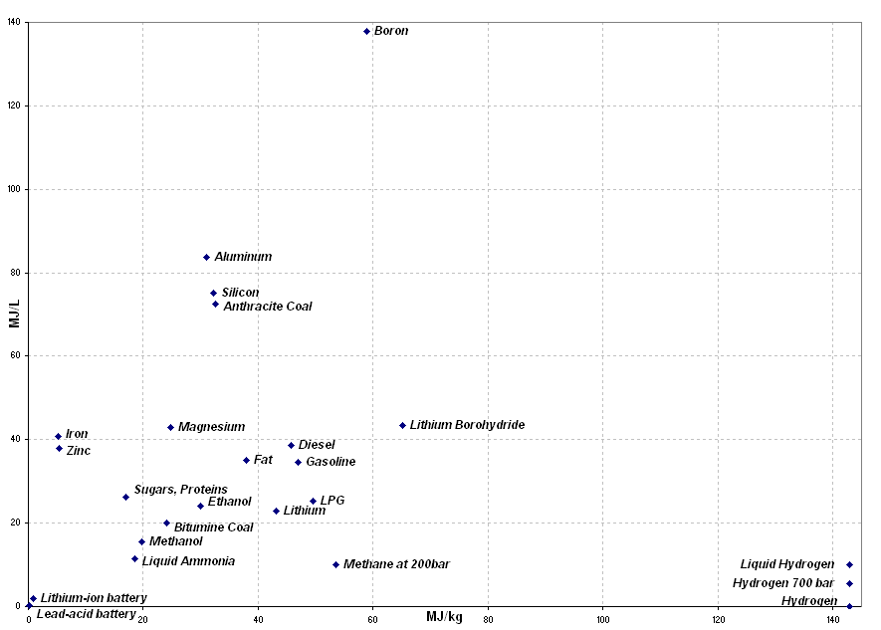
ENERGY DENSITIES

Slide 10
ENERGY DENSITIES
 | BY MASS |  |  | BY VOLUME
 | MJ/Kg | BTU/lb | Relative to Gasoline | MJ/L | Relative to Gasoline
Solar Fusion | 6.40E+07 | 2.75E+10 | 1,379,310
235U Fission | 6.45E+06 | 2.78E+09 | 139,009 | 1.50E+09 | 4.39E+07
Li Ion Battery | 2.6 | 1,119 | 0.06 | 1.2 | 0.04
H2 Fuel Cell | 1.6 | 689 | 0.03
Lead Acid Battery | 0.1 | 43 | 0.00
Liq. Hydrogen | 143 | 61,537 | 3.08 | 10.1 | 0.30
Flywheel | 0.5 | 215 | 0.01
Ni-Cad Battery | 0.18 | 77 | 0.00
Compr. H2, 10,000 psi | 143 | 61,537 | 3.08 | 5.6 | 0.16
Natural Gas | 53.64 | 23,083 | 1.16 | 10.0 | 0.29
Bio Diesel | 42.2 | 18,160 | 0.91 | 33.0 | 0.96
Crude Oil | 46.3 | 19,924 | 1.00 | 37.0 | 1.08
Propane | 49.5 | 21,301 | 1.07 | 25.3 | 0.74
Diesel | 46.2 | 19,881 | 1.00 | 37.3 | 1.09
Gasoline | 46.4 | 19,967 | 1.00 | 34.2 | 1.00
Body Fat, Metabolized | 38 | 16,353 | 0.82 | 35.0 | 1.02
Anthracite Coal | 32.5 | 13,986 | 0.70 | 72.4 | 2.12
Ethanol | 30 | 12,910 | 0.65 | 24.0 | 0.70
Bituminous Coal | 24 | 10,328 | 0.52 | 20.0 | 0.58
Sugars, Carbohydrates | 17 | 7,316 | 0.37 | 26.2 | 0.77
Wood | 10 | 4,303 | 0.22
Household Waste | 9 | 3,873 | 0.19

Slide 11
ENERGY USAGE
Transportation
Lighting
HVAC (Heating, Ventilation, Air Conditioning)
Motors
Industrial Process Energy
Industrial Process Feedstocks

Slide 12
NATURAL GAS & CRUDE PRICES
Go to http://www.nymex.com/
Click “Crude Oil (CL)” or Natural Gas (NG)” – an agreement page will come up
Click “I Accept”
Click “Current Expanded Table” from menu on left, goes out about 8 years.
Contracts are for 1,000 bbl (oil) and 10,000 MMBTU (nat. gas)

Slide 13
Sources of Energy Information
International Energy Agency fact sheets http://www.worldenergyoutlook.org/media/weowebsite/2015/WEO2015_Factsheets.pdf
BP World Statistical Review of World Energy http://www.bp.com/content/dam/bp/excel/energy-economics/statistical-review-2016/bp-statistical-review-of-world-energy-2016-workbook.xlsx

Slide 14
WORLD ENERGY PRODUCTION
Fuel Type | Production, Mtoe*
Petroleum | 4331.2
Natural Gas | 3135.2
Coal | 3839.9
Nuclear | 583.1
Hydroelectric | 892.9
Renewables | 364.9
TOTAL 1347.3
*Mtoe = Million Tons Oil Equivalent = 3.96E13 BTU = 0.0396 Quads

Slide 15
BP Statistical Review Contents
Oil: Proved reserves
Oil: Proved reserves - Barrels (from 1980)
Oil: Production – Barrels (from 1965)
Oil: Production – Tonnes (from 1965)
Oil: Consumption – Barrels (from 1965)
Oil: Consumption – Tonnes (from 1965)
Oil: Regional consumption – by product (from 1965)
Oil: Spot crude prices
Oil: Crude prices since 1861
Oil: Refinery throughput (from 1980)
Oil: Refinery capacities (from 1965)
Oil: Regional refining margins (from 1992)
Oil: Trade movements (from 1980)
Oil: Inter-area movements
Oil: Trade 2014-2015
Coal: Reserves
Coal: Prices
Coal: Production - Tonnes (from 1981)
Coal: Production - Mtoe (from 1981)
Coal: Consumption - Mtoe (from 1965)
Nuclear Energy – Consumption - TWh (from 1965)
Nuclear Energy – Consumption - Mtoe (from 1965)
Hydroelectricity – Consumption - TWh (from 1965)
Hydroelectricity – Consumption - Mtoe (from 1965)

Slide 16
BP Statistical Review Cont’d
Gas: Proved reserves
Gas: Proved reserves - Bcm (from 1980)
Gas: Production – Bcm (from 1970)
Gas: Production – Bcf (from 1970)
Gas: Production – Mtoe (from 1970)
Gas: Consumption – Bcm (from 1965)
Gas: Consumption – Bcf (from 1965)
Gas: Consumption – Mtoe (from 1965)
Gas: Trade movements pipeline
Gas: Trade movements LNG
Gas: Trade 2014-2015
Gas: Prices
Renewables - Other renewables consumption -Twh (from 1965)
Renewables - Other renewables consumption - Mtoe (from 1965)
Renewables - Solar consumption - TWh (from 1965)
Renewables - Solar consumption - Mtoe (from 1965)
Renewables - Wind consumption - TWh (from 1965)
Renewables - Wind consumption - Mtoe (from 1965)
Renewables - Geothermal, Biomass and Other - TWh (from 1965)
Renewables - Geothermal, Biomass and Other - Mtoe (from 1965)
Renewables - Biofuels production - Kboe/d (from 1990)
Renewables - Biofuels production - Ktoe (from 1990)

Slide 17
BP Statistical Review, Concl’d
Primary Energy: Consumption - Mtoe (from 1965)
Primary Energy: Consumption by fuel type - Mtoe (2014-2015)
Electricity Generation - TWh (from 1985)
Carbon Dioxide Emissions (from 1965)
Renewable Energy - Geothermal (Installed capacity)
Renewable Energy - Solar (Installed capacity)
Renewable Energy - Wind (Installed capacity)
Approximate conversion factors
Definitions

Slide 18
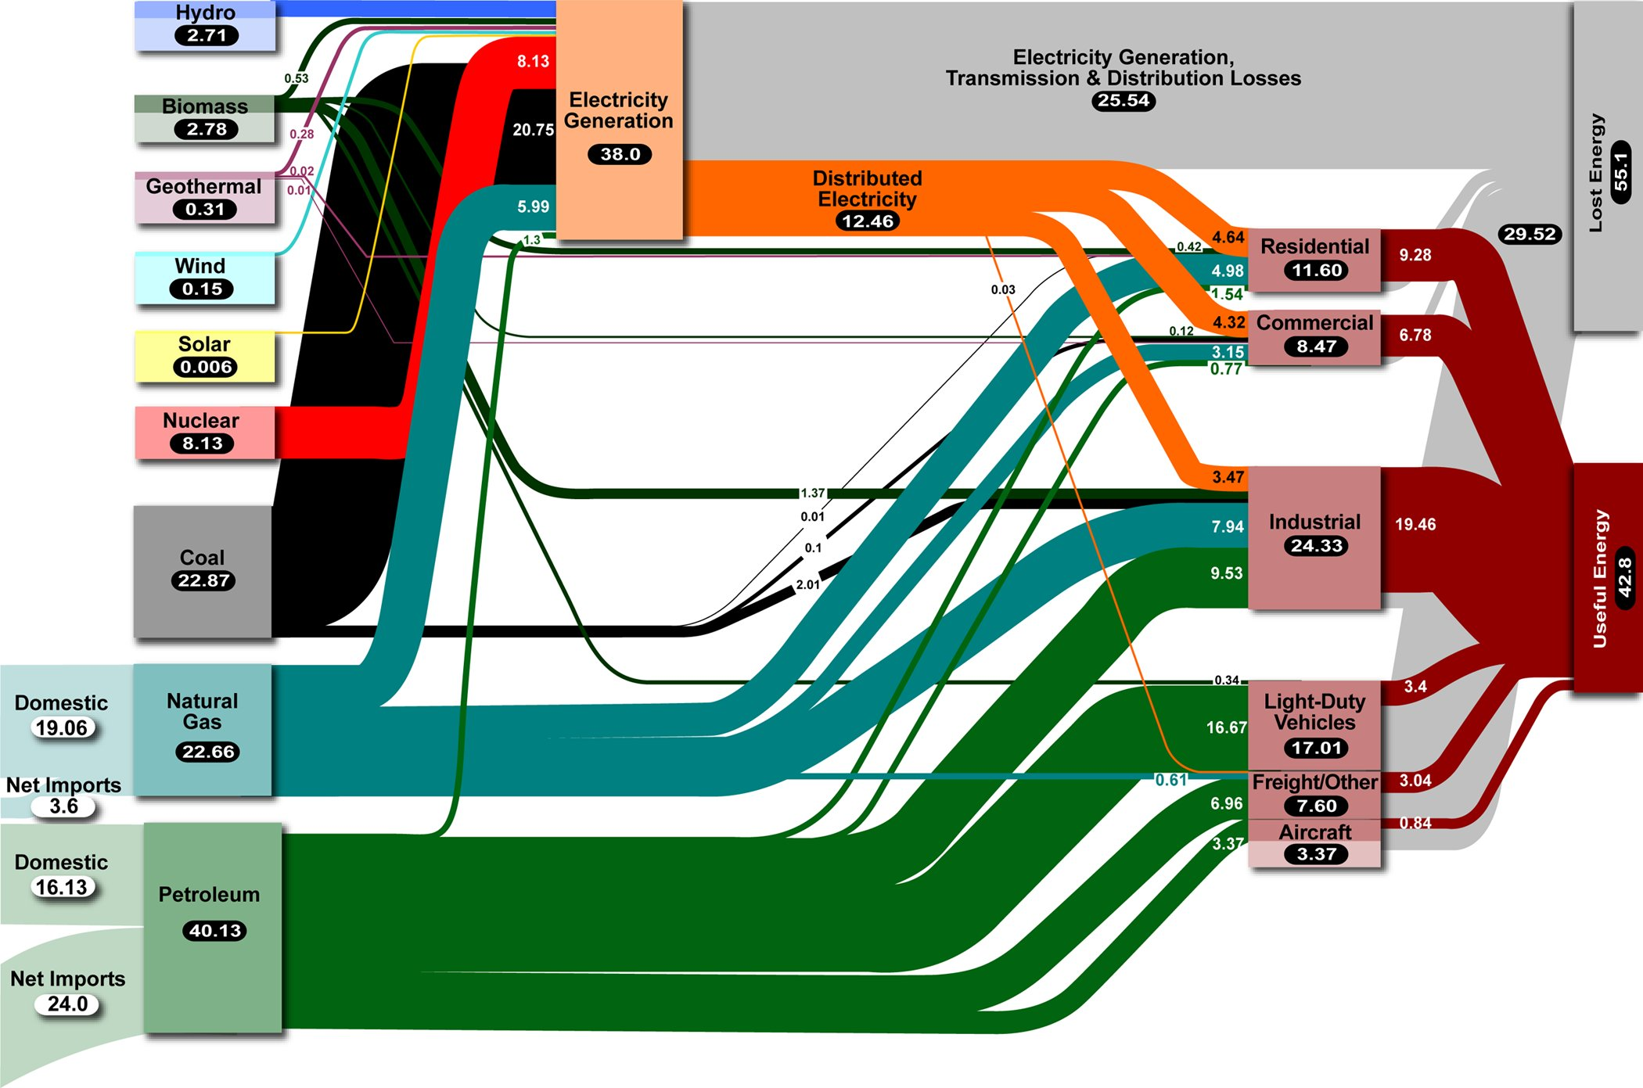
U.S.A. ENERGY FLOW
Units are Quads

Slide 19
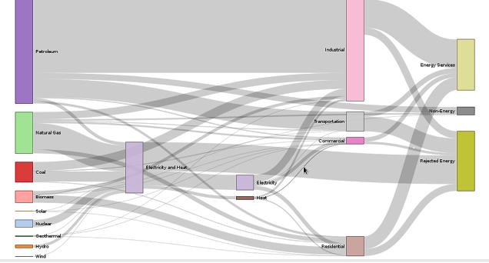
WORLD ENERGY FLOW
Petroleum
Industrial
Useful Energy
Transportation
Nat. Gas
Commercial
Coal
Electricity & Heat
Rejected Energy
Elec.
Biomass
Heat
Nuclear
Hydro
Residential

Slide 20
LET’S GET TECHNICAL

Slide 21
Decimal Prefixes
Nano | 1 billionth | E-9, E-09
Micro | 1 millionth | E-6, E-06
Milli | 1 thousandth | E-3, E-03
Centi | 1 hundredth | E-2, E-02
Deci | 1 tenth | E-1, E-01
Deca | ten | E1, E01
Hecta | hundred | E2, E02
Kilo | thousand | E3, E03
Mega | million | E6, E06
Giga | billion | E9, E09
Tera | trillion | E12
Peta | quadrillion | E15
Exa | pentillion | E18

Slide 22
Mathematical Notation
Unit^n = Unit^{n}, example cm^3 = cm³ = cubic centimeter
En = 10^{n}; examples for n-2: 4.5E-2 = 4.5 x 10⁻² = 0.045 E9 = E09 = 1E9 = 1 billion
Dot over a variable = time rate of change of the variable, example: the time rate of change of velocity is acceleration v = a
Differentials (difference between two values):
Xa – Xb = ΔX for finite differentials = δx for small finite differentials
= dX for infinitesimally small differentials
Angles are symbolized by θ and φ , and are generated according to right-hand-rule; i.e., x to y, y to z, and z to x.
The sum of finite differentials (ΔX) is signified by Σ ΔX
The sum of infinitesimally small differentials (dx) is signified by the integral ∫ dx
Ordinary multiplication operator is “ * ” ; as 2 * 2 = 4

Slide 23
DEFINITIONS - 1
Matter – anything that occupies space and has mass
Mass – how much matter there is in an object, resists acceleration
Scalar - a mathematical entity representing quantity only
Vector – a mathematical entity that has scalar value and direction
Speed – scalar time rate of motion, units of length per unit time
Velocity – a vector: speed and direction
Acceleration – a vector whose scalar value is the rate of change of speed, units of length/(time) ² or l / t²
Force – a vector causing or resisting acceleration of a body with mass
Gravity – acceleration caused by mass, l / t²
Weight – force of gravity on mass ml / t²
Torque – a vector representing the tendency of a force to rotate an object about some axis m l² / t²
Pressure – a scalar, the force per unit area applied to an object in a direction perpendicular to the surface. (pressure within a closed volume is the same in all directions) m / l t^{2 or} or m l⁻¹t⁻²
Work – a scalar physical entity equal to a force moving a mass through a distance parallel to the force m l² / t^{2 or} m l² t⁻²

Slide 24
DEFINITIONS - 2
Energy - a property of objects which can be transferred to other objects or converted into different forms, but cannot be created or destroyed.
Energy – also defined as a scalar physical entity representing the ability to do work
Power – amount of energy transferred or work done per unit of time.

Slide 25
Dimensional Analysis
Every physical entity (mass, velocity, energy, etc.) has specific dimensions
“m” for mass, “l” for length or distance, “t” for time, “T” for temperature, “q” for electric charge, “$” for cost or value.
Area l ²
Volume l ³
Velocity: l /t
Acceleration l /t²
Momentum m l /t mass x velocity
Force m l /t² mass x acceleration
Pressure m/ l t² force / area or force per unit area
Energy, work, torque m l ²/t² as work, force x distance traversed
Density m/ l ³ mass per unit volume
Heat Capacity l ²/t²T change in heat energy per change in unit temperature per unit mass
Power m l ²/t³ energy per unit of time
Current q/t charge per unit of time
Voltage m l /t²q energy per unit charge
Electric rate $t² / m l ² cost per unit of electrical energy (KWh)

Slide 26
TYPICAL UNITS
Mass: grams, Kg, lb, oz, mg
Length: meters, cm, mm, inch, foot, yard
Time: seconds, minutes, hours
Temperature: deg F, deg C, deg K, deg R
Electric Charge: coulomb
Value: dollar

Slide 27
SYSTEMS OF UNITS
cgs = centimeter-gram-second
mks = meter-kilogram-second (SI system)
English = ft, lbm (pound mass), lbf (pound force), BTU, second & hour

Slide 28
CONVERSION FACTORS – by System
UNIT | MKS | CGS | ENGLISH
Length | meter | 10^2 cm | 3.288 feet
Area | sq. meter | 10^4 cm2 | 10.81 ft^2
Volume | cubic meter | 10^6 cm3 = 1,000,000 ml | 35.31 ft^3
Mass | kilogram | 1000 grams | 2.203 lbm
Density | Kilogram/meter^3 | 0.001 g/ml | 0.0624 lbm/ft^3
Velocity | meters /sec | 100 cm/sec | 3.288 ft/sec
Acceleration | meters/sec^2 | 100 cm/sec^2 | 3.288 ft/sec^2
Force | newton, kg-m/sec^2 | 10^5 dynes (gm-cm/sec^2) | 0.225 lbf
Pressure | pascal, newton / m^2 | 10 dyne/cm^2 (baryes) | 0.000145 psi
Energy | joule (newton-meter) | 10^7 ergs, (dyne-cm) | 0.000957 BTU
Energy | Kilojoule | 10^10 ergs | 0.957 BTU
Energy | watt-hour |  | 3.443 BTU
Power | watt (joule / sec) |  | 1.34 HP
Temperature | degree Celsius or Kelvin |  | 1.8 deg Fahrenheit or Rankine
Enthalpy | joule/g = Kjoule/Kg |  | 0.43 BTU/lbm
Entropy | joule/Kg-degK |  | 0.239 BTU/lbm-degR
Heat Capacity | joule/Kg-degK |  | 0.239 BTU/lbm-degR

Slide 29
More Useful Conversion Factors
1 lb_{m} = 454 grams = 0.454 Kg
1 liter = 1E-3 cubic meters = 0.264 gallons
1 HP = 0.746 KW = 550 ft-lb_{f}/sec = 33,000 ft-lb_{f}/sec
1 micron = 1E-6 meter
1 BTU = 778 ft-lb_{f} = 1,055 joules = 1.055 Kj
1 KPa (KiloPaschal pressure) = 0.145 lb_{f}/in^2 (psi)
1 electron volt (eV) = 1.602E-19 Joules
1 lb_{f} = 4.448 Newtons
1 Quad = E15 BTUs
1 Mtoe (Megatons oil equivalent) = 3.96E13 BTU
1 Metric Ton = 1 Tonne = 1,000 Kg = 2,200 lb

